Slide 1
The time is 800 AD
http://www.bbc.co.uk/learningzone/clips/13970.html

Slide 2
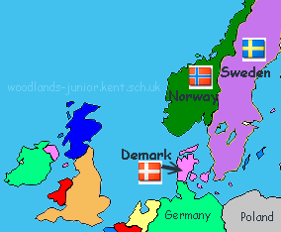
The Vikings live in Scandinavia in the countries of Denmark, Norway and Sweden. This is a very cold part of Northern Europe.

Slide 3
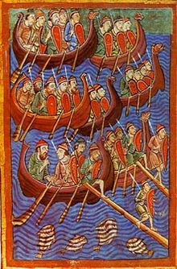
They are sea faring folk who are renown boatsmen and fishermen.
Assign half class as Vikings to North of classroom.

Slide 4
The Anglo Saxons live in Britain.

Slide 5
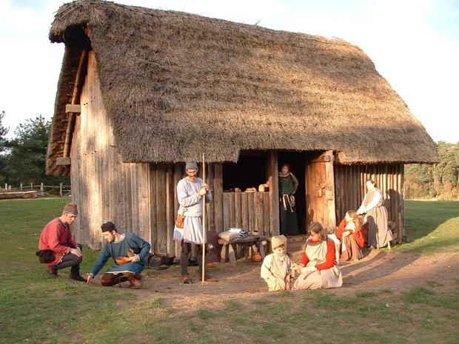
They are farmers growing corn and rearing animals.
Assign half class as Anglo Saxons

Slide 6
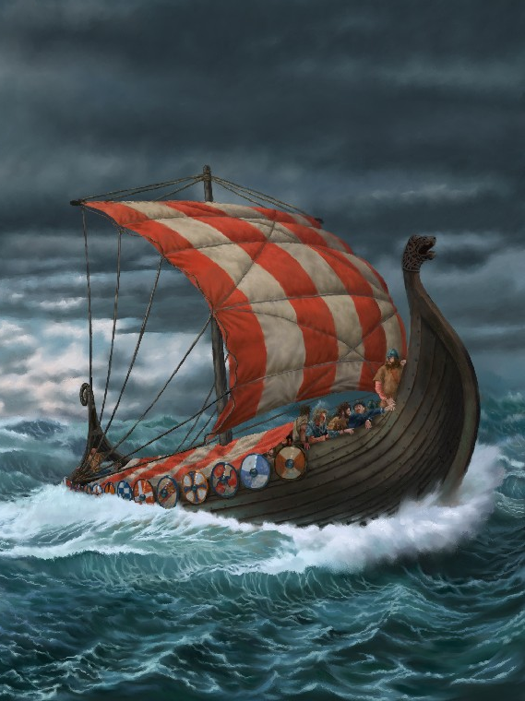
The Vikings with their long boats can travel across Europe to trade. They are coming to Britain. In this game each country will make and trade goods. The winner is the country with the most goods at the end.

Slide 7
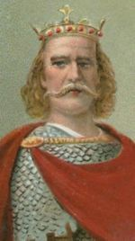
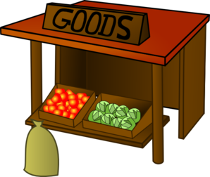

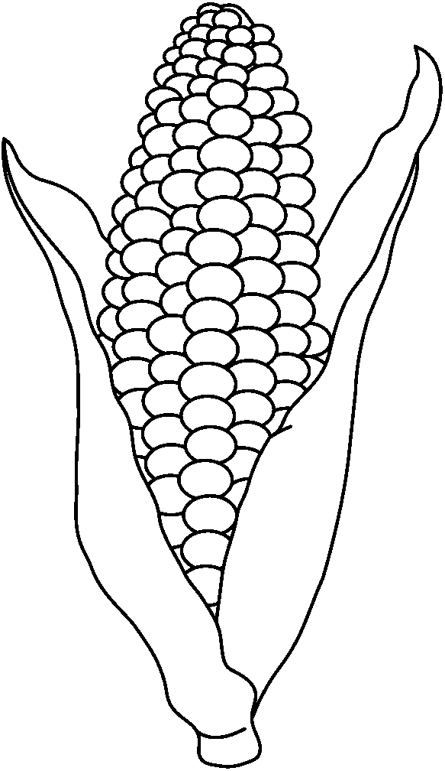


Anglo Saxons– 1 king, 3 people are traders and the rest are divided into farmers making corn, growing apples, wool and herdsmen rearing meat.
King Harold
Traders will collect and trade with the Vikings
Farmers and herdsmen.
Responsible for counting goods traded and have made.

Slide 8
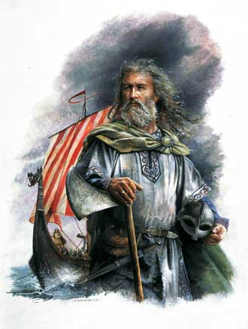
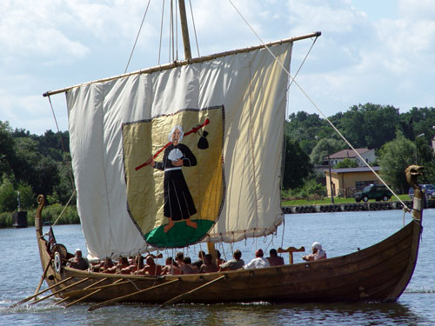
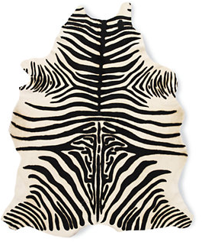


Vikings – 1 king, 3 traders and the rest are fishermen and skinners.
Traders will collect the goods, travel in the long ship to Britain and trade with the Britains.
King Cnut the Great
Fishermen and skinners catch fish, tusks
skin animals for trade.
Responsible for counting goods traded and have made.

Slide 9
Production
Make the goods by cutting them out. Only one paper at a time.
Traders collect.
King makes sure everyone has materials for the job.
Traders collect from the producers

Slide 10
Trade - Viking traders set sail
in long boats and come to England to trade.

Slide 11
Trade
Traders exchange goods. Try and get the best deal you can.

Slide 12

End of Round
How did each team do?
Kings count up.
The Vikings lose their traders. They decide to settle in England as it is warmer. Britain gain more workers.

Slide 13
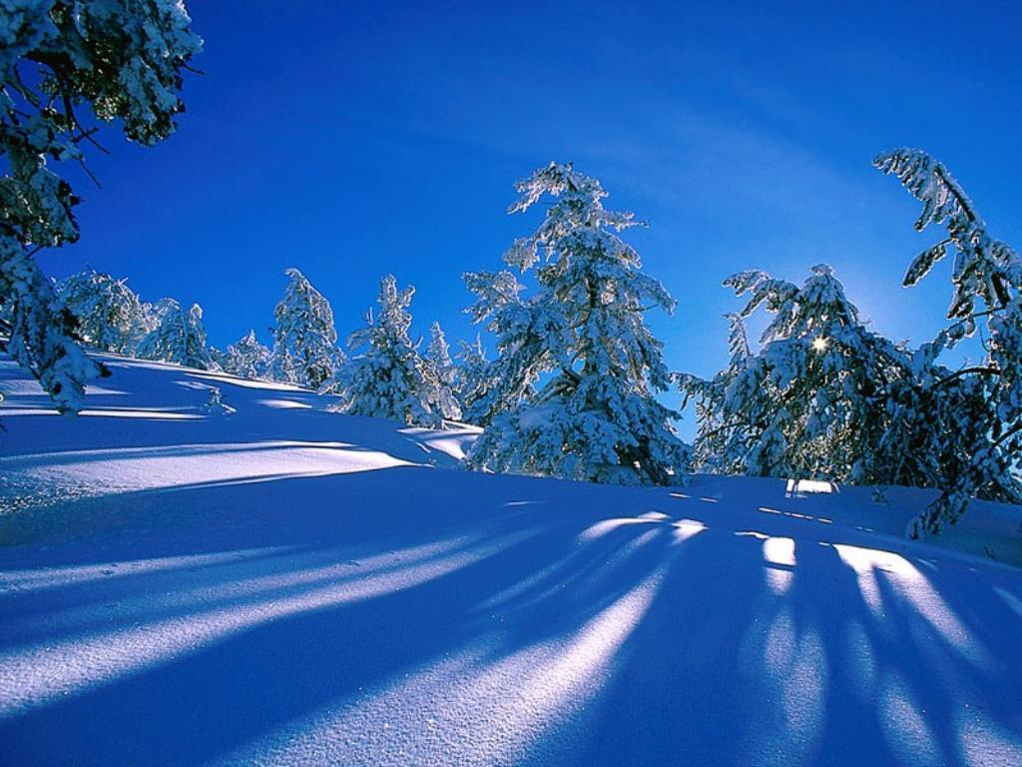
h
End of Round 1.
A very cold winter in Scandinavia means there is very deep snow. It is hard to cut down trees to make tools in the bad weather. Vikings lose 2 sets of scissors and must take it in turns cutting out.

Slide 14
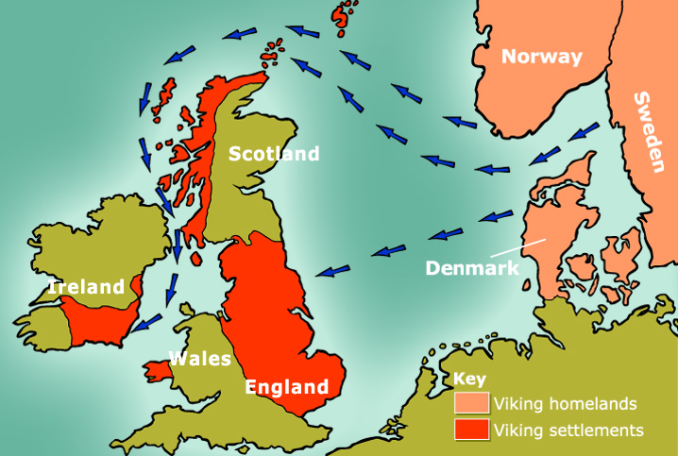
End of Round 2.
The Vikings lose their traders. They decide to settle in England as it is warmer. Britain gain more workers.

Slide 15
Round 3
Another cold winter. The sea is frozen and there is more deep drifting snow in Scandinavia. It becomes more difficult to fish, animals die and wood is hard to get. The Vikings cannot use templates any more. They must draw and then cut out their goods. English can reject if too small or too big.

Slide 16
End of Game
End of Round 3.
Who has won?
Why did the Anglo Saxons win?
What should the Great King Cnut do now?
What have you learnt about the Vikings?
What would you like to find out about the Vikings?
http://www.bbc.co.uk/learningzone/clips/13970.html

